Slide 1
Aviation Safety Analysis
Presented by: Beth Mwangi
Date: 28th April 2025

Slide 2
Project overview
Analyze Aviation Accident Data from the National Transportation Safety Board(NTSB)
Time frame is between 1962-2023
Recommend 3 actionable insights for decision making

Slide 3
Business Problem
Company expanding into aviation.
Need to identify low-risk aircraft options for safe investment.
Deliver actionable insights to inform aircraft purchase decisions.

Slide 4
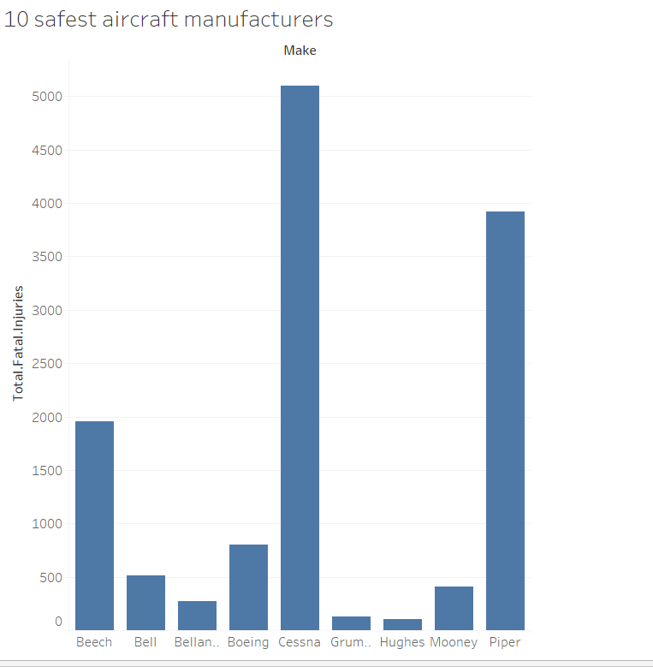
Analysis 1 - Identifying Safest Aircraft Manufacturers

Slide 5
In this analysis, we focused on the makes that has lowest fatalities based on the historical data from NTSB. Findings:
We found that the safest top 10 aircraft manufacturers were:
Hughes, Grum, Mooney, Bellan, Bell, Boeing, Beech, Piper and Cesna
They have proven to be the most common makes with the lowest fatilities
We recommend that the company should consider purchasing aircrafts of this Make’s since they are safer.

Slide 6
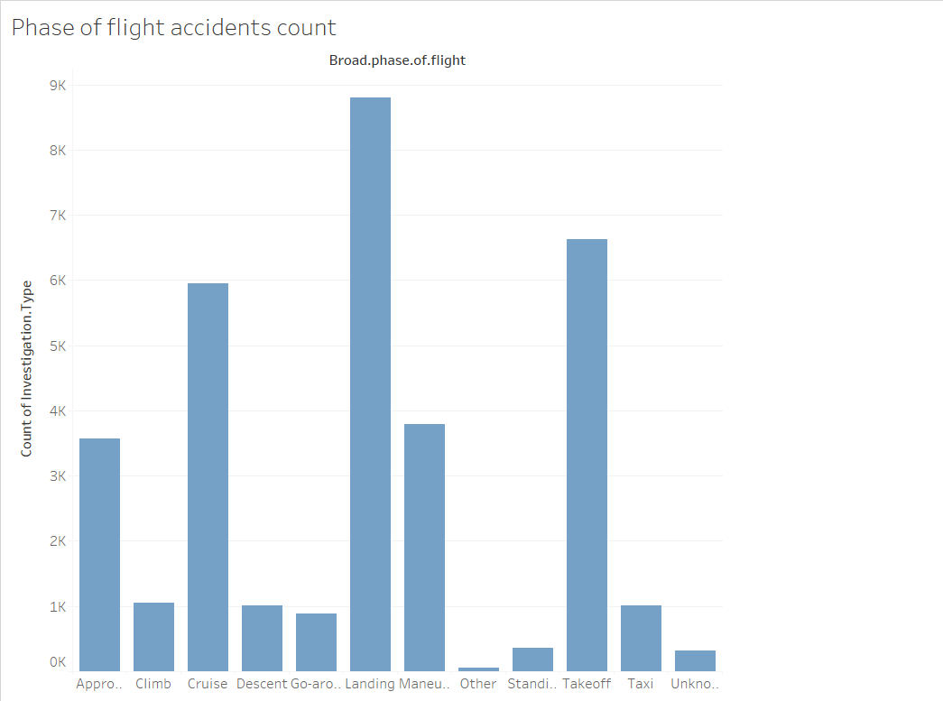
Analysis 2: Risk by phase of flight

Slide 7
Findings and Recommendation:
From our analysis , most accidents happen during landing, take- off and cruise
This is because from the NTSB data analysed, the three phases had the highest number of accidents occurring,
We recommend that the company should invest in specialized training of pilots for the three phases.

Slide 8
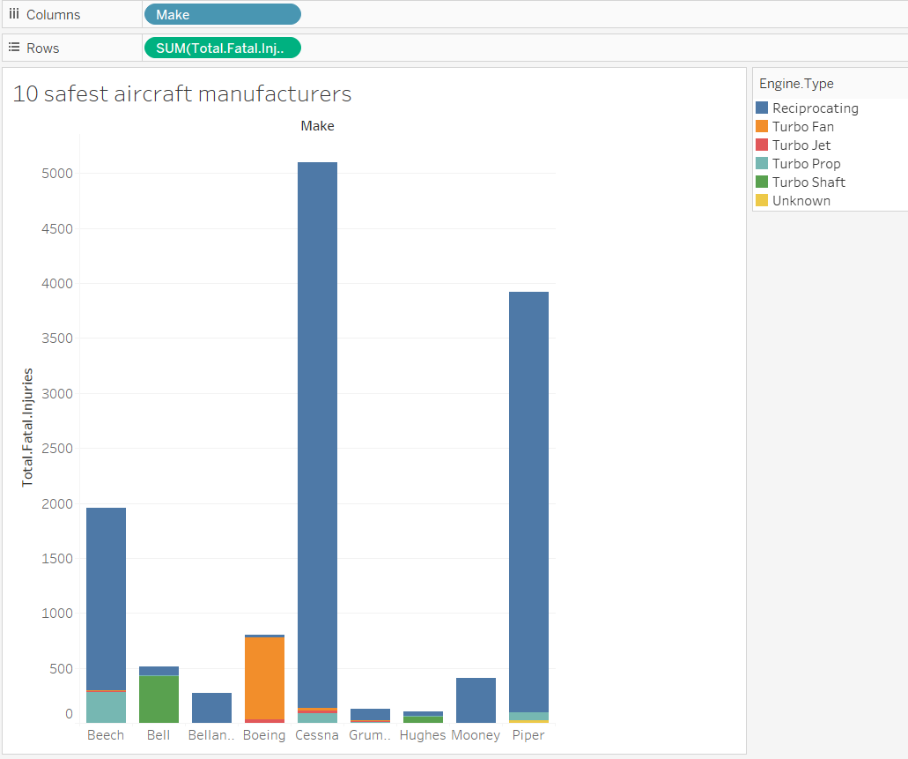
Analysis 3 : Best Engine Types
We did our analysis by comparing the engine types with the number of accidents occurred from our data from NTSB

Slide 9
Findings and Recommendation:
We found that Reciprocating Engine Type had the highest number of accidents occurring during 1962-2023.
We therefore would recommend the company to avoid inventing in aircrafts with such engine , they should however consider investing in Aircraft with turbo jet since they had the lowest number of accidents.

Slide 10
Conclusion
We recommended ‘HUGHES’ make with a Turbo Jet engine to as the safest aircraft to purchase.
We would also recommend specialized training for pilots during landing, take-off and cruise to mitigate risk
Company should focus on risk management during key phases to enhance safety.

